Slide 1


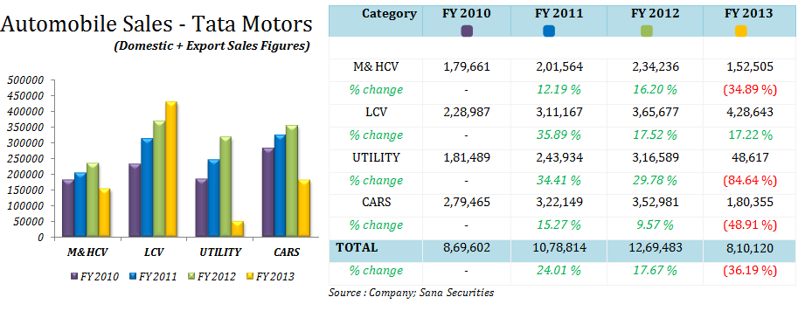
TATA MOTORS
Tata Motors Limited is an Indian multinational automotive manufacturing company, headquartered in the city of Mumbai, India which is part of Tata Group. The company produces passenger cars, trucks, vans, coaches, buses, luxury cars, sports cars, construction

Slide 2
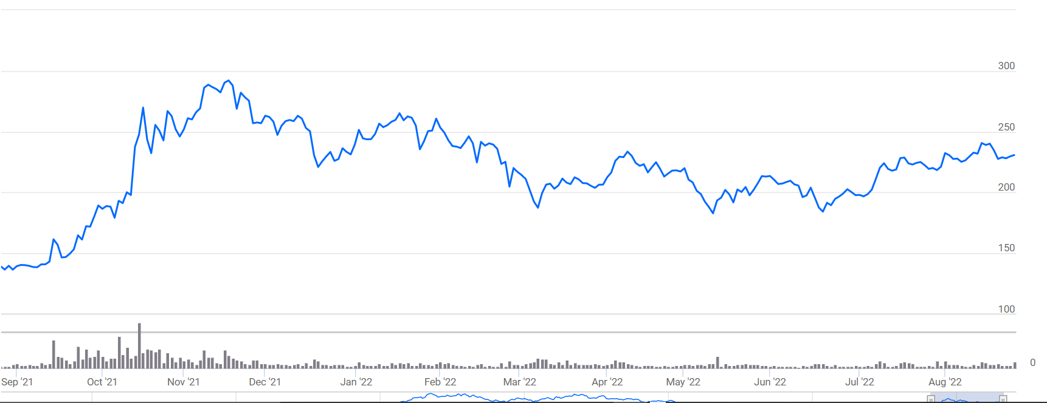
Chart Of The Day: How far is Tata Motors DVR away from the stock?
Tata Motors DVR

Slide 3
Tata Motors DVR Dividends: The DVR Holders receive a higher dividend on Face Value making the Dividend yield higher for DVR Holders.
Dividend
Date | Tata Motors DVR | Tata Motors Equity
03-Aug-09 | 6.5 | 6
10-Aug-10 | 15.5 | 15
19-Jul-11 | 20.5 | 20
18-Jul-12 | 4.1 | 4
30-Jul-13 | 2.1 | 2
09-Jul-14 | 2.1 | 2
18-Jul-16 | 0.3 | 0.2

Slide 4





Digital Marketing Metrics Pyramid
Stock Radar: Down 20% from highs! Tata Motors is a good buy-on-dips stock
Tata Motors
NSE 1.27 % Ltd, part of the automobile sector, has fallen by about 20 per cent from its recent high but technical suggest that the stock is holding on to its crucial support levels and any dips from here on could be looked at going long. Tata Motors saw a steep fall of about 20 per cent from its recent high of Rs 536.50 recorded on 17 November 2021 to Rs 429.60 on 27 May 2022.
Qualified leads
60%
Increase
105%
Cars
43%
The Result
43%
increase in car sales
60%
increase in qualified leads
105%
increase in social media

Slide 5

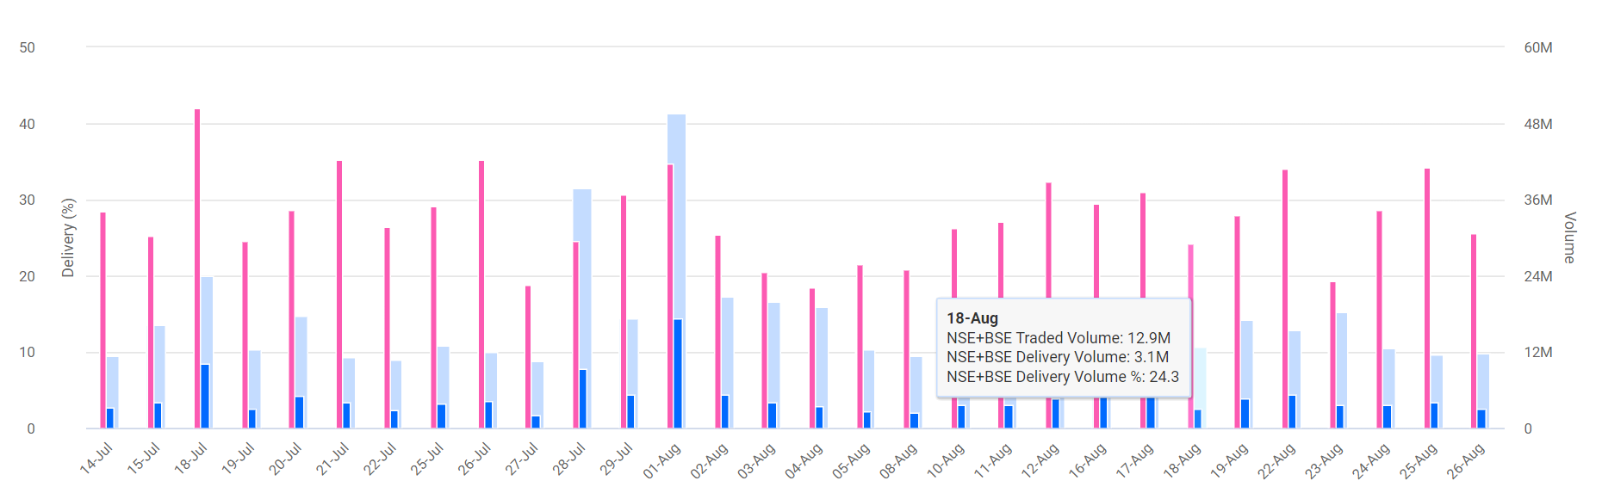
Delivery percentage and Volume Analysis for Tata Motors Ltd.
TATA MOTORS LTD. DAY PIVOT LEVEL
PIVOT
RESISTANCE
R1469.02
R2472.98
R3475.52
SUPPORT
S1462.52
S2459.98
S3456.02

Slide 6
Synopsis ​Tata Motors said that its total sales in the domestic and international market for July 2022 stood at 81,790 vehicles, compared to 54,119 units during July last year . The company's domestic passenger vehicle sales in July stood at 47,505 units, a YoY growth of 57 per cent. In the commercial vehicle segment, the sales were at 34,154 units, recording YoY growth of 43 per cent.
Tata Motors said that its total sales in the domestic and international market for July 2022 stood at 81,790 vehicles, compared to 54,119 units during July last year. The company's domestic passenger vehicle sales in July stood at 47,505 units, a YoY growth of 57 per cent. In the commercial vehicle segment, the sales were at 34,154 units, recording YoY growth of 43 per cent. "Domestic sale of MH&ICV in July 2022, including trucks and buses, stood at 12,012 units, compared..

Slide 7
Year Wise Data

